Slide 1
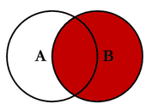
RIGHT JOIN
SELECT B.ANIMAL_ID, B.NAME FROM ANIMAL_INS A
RIGHT JOIN ANIMAL_OUTS B
ON A.ANIMAL_ID=B.ANIMAL_ID
WHERE A.ANIMAL_ID IS NULL

Slide 2
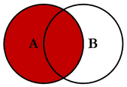
LEFT JOIN
SELECT B.ANIMAL_ID, B.NAME FROM ANIMAL_INS A
LEFT JOIN ANIMAL_OUTS B
ON A.ANIMAL_ID = B.ANIMAL_ID
WHERE B.DATETIME < A.DATETIME
ORDER BY A.DATETIME

